Slide 1
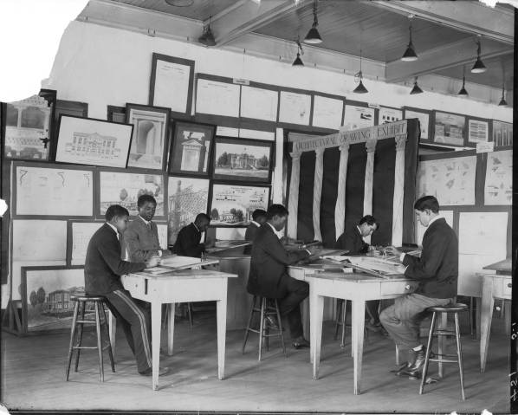
The HBCU LA Digital Initiatives Project Update
Students in an architecture class. Tuskegee University. Used with permission.
Janice Franklin, Ph.D., and Cedric Davis, MBA, MLS
October 10, 2016
HBCU Library Alliance Membership Meeting
Atlanta, Georgia

Slide 2
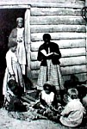
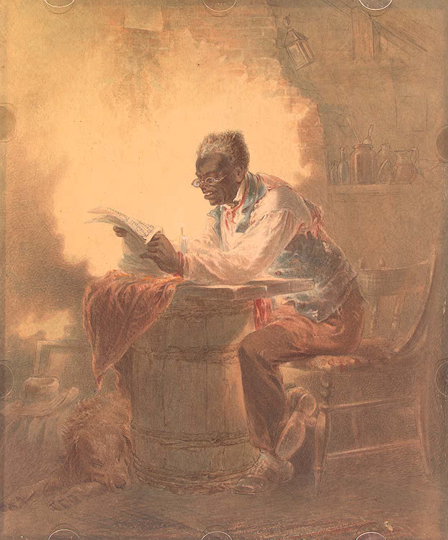
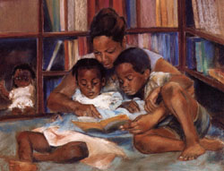
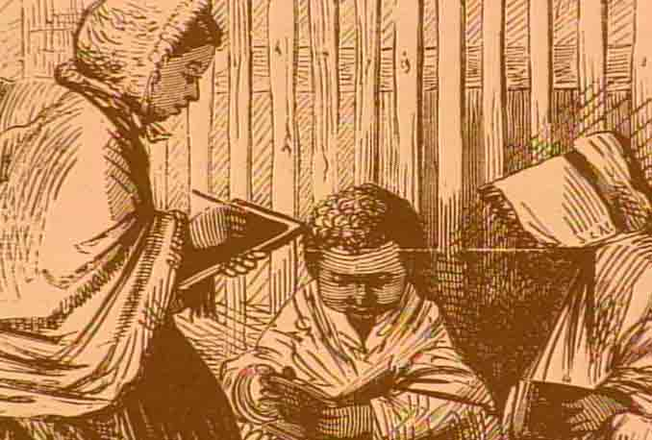
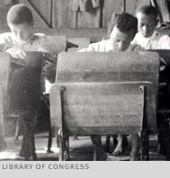
A LEGACY OF LEARNING

Slide 3
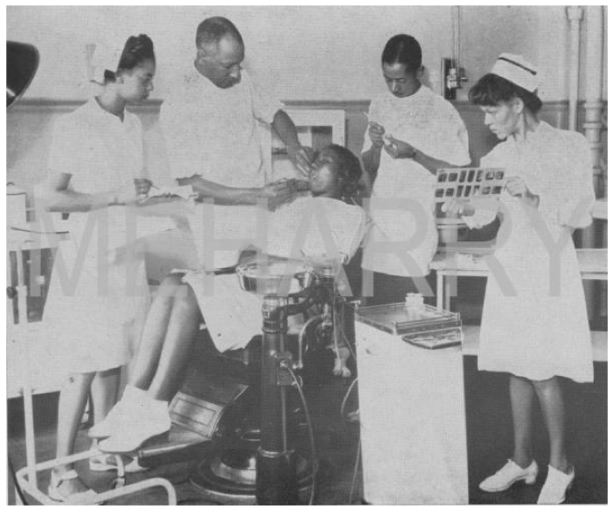
The HBCU LA – Cornell University Library Digital Initiative
Began in summer 2005 to build a cadre of HBCU library staff trained in collaborative digital preservation and access.
Other Partners: The Andrew W. Mellon Foundation, Solinet/LYRASIS
Dental team at work. Meharry Medical College. Used with permission.

Slide 4
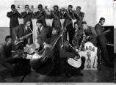
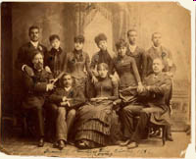
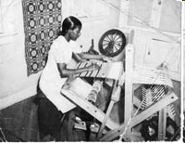
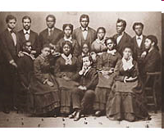
http://contentdm.auctr.edu
Bama State Collegians
1866 First Graduating Class, Virginia State University
Student in Tapestry, Tuskegee University
1874 Singers, Hampton University
Gymnasium of Alabama State College (ASU)
Notes:
Janice’s piece
Over 10,000 images, 22 participating institutions

Slide 5
The Collection
Celebrates the founding of HBCUs
Encourages Scholarship
Fosters Collaboration and Partnerships
Is a Teaching Tool
Provides Access to Hidden Treasures
Is a multimedia collection
Is a Valuable Asset To Be Sustained
Currently over 16,000 images from 23 HBCUs

Slide 6
Update: “We’re On the Move”
The Digital Initiatives Committee: ”Re-Engaged” Members:
Chair and Co-Chair: Janice Franklin, Cedric Davis/ASU
Loretta Parham, Christine Wiseman/AUC Woodruff
Monika Rhue/ Johnson C. Smith and HBCU LA Board
Adrienne Webber/Maryland Eastern Shore
Elsie Weatherington/Virginia State
Sandra Phoenix/HBCU LA
Recent Accomplishments since May, 2016:
Assessing Value and Direction: The Membership Survey
The Goal: Building Collections, Building Community,
Building Sustainability

Slide 7
“The Power of Collaboration”
The mythic Sankofa bird of Ghana
“Looking Back… Moving Forward”

Slide 8
Conclusions
We need Collections, Community, Sustainability
There is Value in Multi-Type collaboration
Communication is Essential for Next Steps
The Digital Library Levels the Playing Field
New Applications for the Collection will be Explored
Your Input and Collaboration Is Appreciated

Slide 9
The Digital Initiative Survey Summary
Notes:
Purpose of Survey:
Under the recommendation of the Digital Initiatives Committee, the survey was sent to 82 HBCU Institutions on September 13. The purpose of the survey was to gather information from members regarding interest, needs and concerns in support of the HBCU Library Alliance Digital Initiative. The Digital Initiatives Committee will use your responses to develop strategies and future directions of the initiative.
Sixty four of the 82 institutions responded to the survey, 78% participation rate.

Slide 10
What do you consider as value of the HBCU Library Alliance Digital Initiative?
Keeping our history alive
Making materials accessible
Centralized collaborative platform
Preservation of HBCU history
Digital Initiative provides resources & training
Notes:
Question 22
What do you consider as value of the HBCU Library Alliance Digital Initiative? Is it relevant?
Answer Options
Response Count
58
answered question
58
skipped question
6

Slide 11
If you have not received training, please identify the area where training is needed.
Notes:
Question 5
If you have not received training, please identify the area where training is needed (check all that apply).
Answer Options
Response Percent
Response Count
Digitization techniques and standards 88.6% 31
Copyright/ownership issues 80.0% 28
Metadata standards 88.6% 31
Other (please specify) 17.1% 6
answered question 35
skipped question 29

Slide 12
What subject areas, other than founding documents, would you recommend to further develop the collection?
Notes:
Question 14
answered question 61
skipped question 3
What subject areas, other than founding documents, would you recommend to further develop the collection? Answer Options Response Percent Response Count
Historical themes and periods, e.g., slavery, civil rights 78.7% 48
Cultural themes and time periods, e.g., dance, the visual arts 59.0% 36
Personalities and notable alumni 72.1% 44
Other suggested subject areas 14.8% 9

Slide 13
How can the HBCU Library Alliance support your digital activities?
Provide funding and training
Provide information on grant opportunities
Provide mentors who are participants in the portal for those who are interested
Support digital activities by providing training and mentorship to create and sustain a digital project
Notes:
Question 15
answered question 59
skipped question 5
How can the HBCU Library Alliance support your digital activities?
Answer Options
Response Count 59

Slide 14
What improvements would you propose for the portal?
Portal needs to be responsive for mobile devices and varied screen sizes. Font size is too small
Perhaps increased marketing of the portal
Work to include more unrepresented (or under-represented) institutions and collections
Additional server space to upload items and retraining
Notes:
What improvements would you propose for the portal? http://hbcudigitallibrary.auctr.edu
Answer Options
Response Count
43
answered question
43
skipped question
21

Slide 15
Improvments Cont…
Assisting those of us who are not currently apart of the project to get up and running as soon as possible
Allow institutions to apply for mini grants in order to help digitize their unique collections.
Expanding opportunity for hosting collections and reaching out to those HBCU who have closed but their history needs preservation.
Refresh training for current members and a grant to include several more institutions

Slide 16
Survey Summary

Slide 17
Next Steps
Make as much of the archives and special collections digital as possible
Add more to the collection
More involvement from institutions
Digitize more and develop plans for preservation
Create a mobile application or create a more dynamic collection website with online exhibits and interactive content.
Notes:
Question 21
What do you consider as next steps for the project?
Answer Options
Response Count
52
answered question
52
skipped question
12

Slide 18
Thank You

Slide 19
Thank You

